Slide 1
Advanced Systems Analysis and Design Giving and Receiving Feedback SOFT 30121 L15 Presented By Nigel King ACMA CGMA PCM Nigel.King@ntu.ac.uk

Slide 2

Giving and Processing Feedback

Slide 3
Introduction
It may seem obvious, but it is a perennial problem to get people to review designs. It is also a something that makes you vulnerable, so you have to get yourself emotionally equipped to solicit and process feedback. You can only scale if you can coordinate and you can only coordinate if you review each others work. The worst case is that people have created designs in isolation that either overlap, do not integrate or are redundant to one another because their were no reviews.

Slide 4
The Big Picture
Understand the importance of giving feedback on your colleagues documents
Understand some protocols in the mechanics of giving feedback
Have some understanding of how to give positive guidance
How to receive and review feedback
How to edit in response to feedback and give disposition
Keeping track of versions and reasons for changes.

Slide 5
First, be kind to your reader
1Characteristics of Effective Technical Communication
1.1.1 Accuracy: Use the right word.
1.1.2 Clarity: Be direct.
1.1.3 Conciseness: No unnecessary words.
1.1.4 Coherence: Be easy to follow.
1.1.5 Appropriateness: Use language familiar to your audience.

Slide 6
The importance of giving feedback on your colleagues documents
Get other perspectives
Ensure that your perspectives are communicated
Prevent aspect of designs being incoherent or redundant
Forces design issues to be aired before the expense and emotional commitments when designs and build progresses
We used to find that a design that needed multiple product teams to give assent before we can call the design closed, we needed about 100 issues recorded and less than 20 open before we could bring a design in to land.
Unseen aspects get recorded.
Ambiguous language gets tightened.
Stakeholders get a sense of influence and ownership.

Slide 7
Some downsides to soliciting feedback
It slows you down to get feedback.
It dilutes your original ideas
It reduces your sense of ownership of the solution
You have additional tasks to reconcile perspectives and give disposition.

Slide 8
Protocols in the mechanics of giving feedback
I am illustrating with word online.
Use whatever tool your team is comfortable with.
Word
Google Docs
Atom with Git
Acrobat
Dropbox

Slide 9
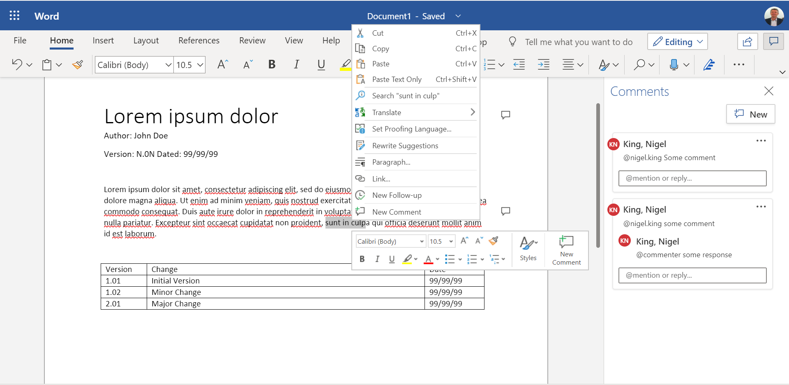
Protocols in the mechanics of giving feedback

Slide 10
Protocols in the mechanics of giving feedback
Document Level Feedback
I normally give document level feedback as a comment attached to the title.
Examples of document level feedback.
Include person X in the review
Take at look at product Y. It seems to do something similar.

Slide 11

Protocols in the mechanics of giving feedback
Text Level Feedback
Select the text that you have an issue with.
Right Click and Add Comment

Slide 12
Protocols in the mechanics of giving feedback
When responding, I generally put the text that I am removing and the text that I am replacing in the comment. Word has the capability to address the response to the commenter.

Slide 13
Have some understanding of how to give positive guidance
Be specific. Avoid general comments that may be of limited use to the receiver. Try to include examples to illustrate your statement. As well, offering alternatives rather than just giving advice allows the receiver to decide what to do with your feedback.
Be realistic. Feedback should focus on what can be changed. It is useless and frustrating for recipients to get comments on something over which they have no control.
Own the feedback. When offering evaluative comments, use the pronoun “I” rather than “they” or “one,” which would imply that your opinion is universally agreed on. Remember that feedback is merely your opinion.
Be timely.

Slide 14
How to receive and review feedback
Be open. This means being receptive to new ideas and different opinions. Often, there is more than one way of doing something and others may have a completely different viewpoint on a given topic. You may learn something worthwhile.
Understand the message. Make sure you understand what is being said, especially before responding to the feedback. Ask questions for clarification if necessary.

Slide 15
Why is feedback sometimes less than professional
People use it as a mechanism to establish position
It may be advantageous to them or their organization to slow your design.
They have not actually read the design but need to “show up”

Slide 16
Handling Feedback that may be less than professional
You have power over your mind – not outside events. Realize this, and you will find strength.
Don’t be overheard complaining… Not even to yourself.
Be tolerant with others and strict with yourself.
Reject your sense of injury and the injury itself disappears.
Marcus Aurelius AD 121 AD 180
Emperor of Rome

Slide 17
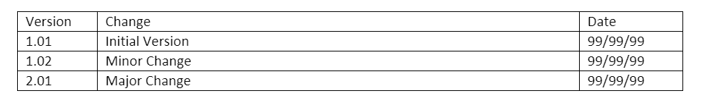
Keeping track of versions and reasons for changes
When I have processed “enough” responses, I try and summarise the changes in the version history.

Slide 18
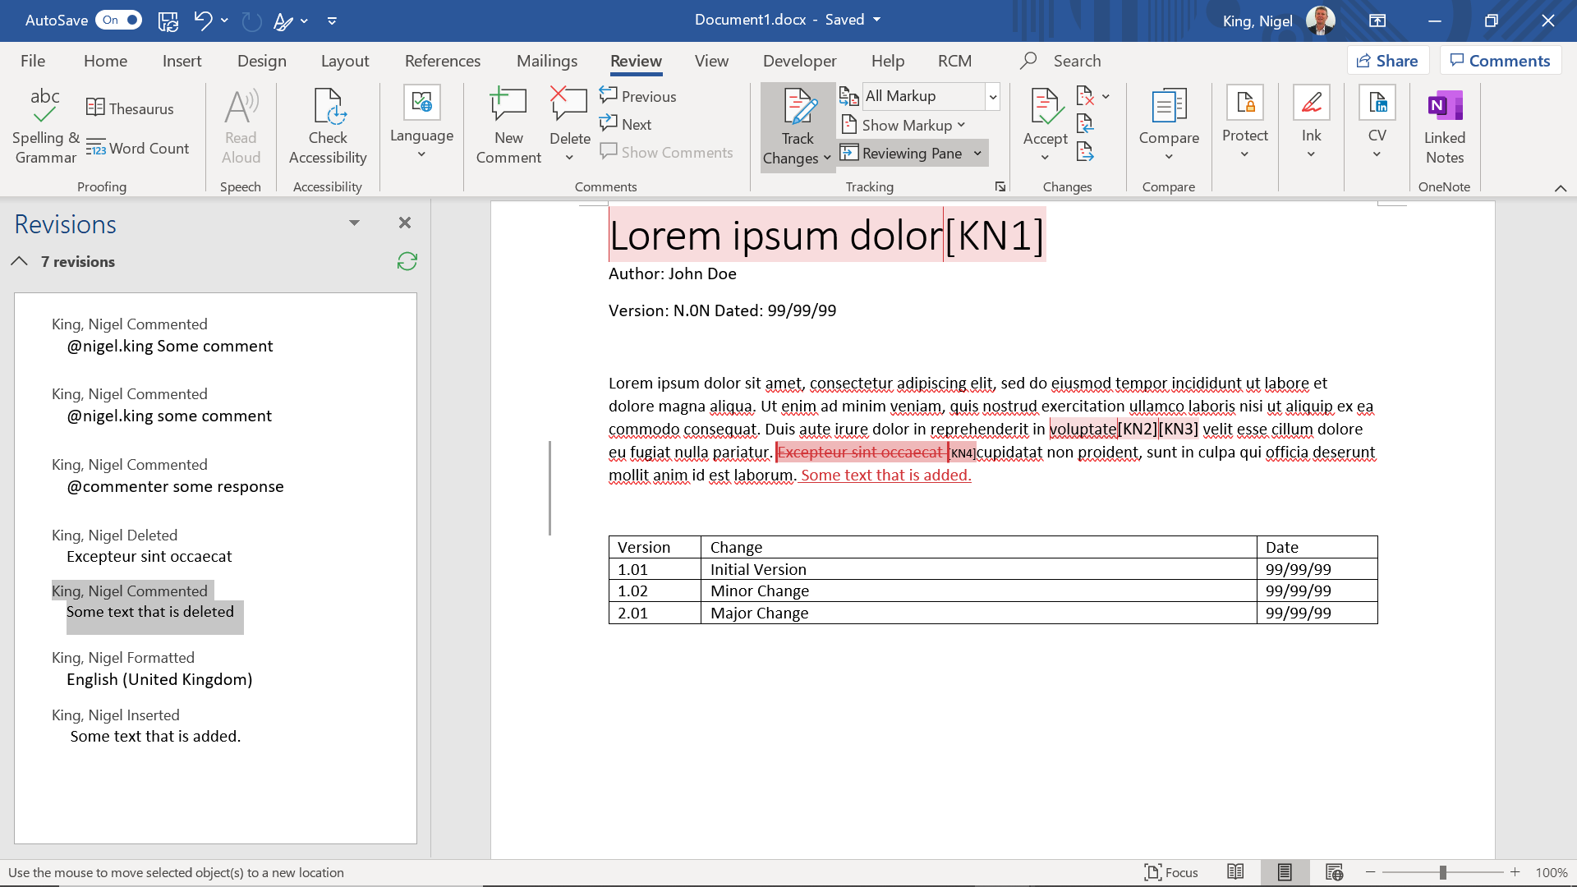
Keeping track of versions and reasons for changes
Within faculty at NTU we have a protocol of publishing, both the latest version with all feedback processed and with all changes highlighted.

Slide 19
Resources
Dempsey, J.V. and G.C. Sales (Eds.). (1993) Interactive Instruction and Feedback. Educational Technology Publication. NJ: Englewood Cliffs
London, M. (1997) Job Feedback: Giving, Seeking, and Using Feedback for Performance Improvement. Mahwah, NJ: Lawrence Erlbaum Associates
McGill, I. and L. Beaty (1995) Action Learning. 2nd Ed. London: Kogan Page Ltd.

Slide 20
Next Term
Source Control Systems

